Slide 1
Using Salt Environments and Formulas to Manage Safe Large-Scale Deployments
CenturyLink CDN
November 18, 2019
Notes:
Start time: 0:00
Length: 1
Transition: None

Slide 2




A Problem of SCALE
- OR -
Matt
Brad
Erik
A homogeneous network lasts only until the 1st deployment
Notes:
Start time: 0:01
Length: 3
Transition:
Manage a very large network – Always Diverging
Need CM solution
Supports Variation
Minimizes risk
How many of you operate your networks at scale? (Maybe 50 machines or more)
How many of you think your network has too much variation, too many configurations, and too much complexity?

Slide 3
Framing the problem
Deployment Size
! ~20K Servers
! 6 continents
SLA
24x7 – (no maintenence windows)
In-place staggered upgrades
Software Deployments
Cadence - Variable but most 1x a month
Software and configuration changes
Repair Automation
No touch repair/rebuild of servers for common issue
Can happen at any time
Server Roles (>20)
Nameserver
Caching (on the edge)
Provisioning
Release State (5)
Development
QA
PROD
Trial – Engineering Trial - (alpha)
NRT – Network Readiness Testing - (beta)
GA – General Availability - (stable)
Trial
Role
5%
NRT
15%
GA
80%
Notes:
Start time: 0:04
Length: 4
Transition:
Now we know the problem – What are guidelines for resolving it.
Slide Goal: Identify scale and parameters for CM in CDN
Specifically Define:
Server Roles
Release States
Software Deployment parameters
Repair Automation

Slide 4
Requirements
Production
Must support simple promotion from one release state to the next
Server roles must share Salt States and Formulas
Repair Automation must bring any server back up to its prior state
Must support server moves between both release states and roles
Deployments must only affect a single release state and role
GA
NRT
Trial
Release State Promotion
QA
Dev
Notes:
Start time: 0:08
Length: 4
Transition:
Have a problem
Have the requirements
What tools do we have to work with?
Slide Goal: How to do we take the definition of the problem and translate to high level requirements.
Spend time on locking change to specific Release State and Role. – Requirement 1.
Deploying to one Release State/Role combination should never affect other release states/roles.
Move smoothly through the process from alpha -> beta -> stable.
If both Caching and nameserver manage the bind service, they should use the same formula to manage
One of the goals of using salt – modularity and code reuse.
A server falling offline because of bad hard drive must come back online in the same state as before even if rebuild required
We always want to understand the state of our network. (No uncontrolled upgrades.)
Network Flexibility.
Server A moves from Caching server GA -> Caching server Trial
Server B moves from Caching GA -> nameserver GA
Update Diagram – Cloud Diagram showing migration through release states

Slide 5
How do we accomplish this?
 | Technology | Details
Salt | Formulas | Formulas are pre-written Salt States.
 | Environments | A state tree directory containing a set of state files to configure systems.
 | External Pillar | Mechanism for generating pillar data by calling external pillar interfaces
Version Control | Repos | Independently deployable repo for each formula
 | CI/CD | Gitlab deploys each formula into a /srv/versioned_formula/<formula>_<version> directory, enabling deployment of N formula versions to the same salt-master
 | Git hooks | Guarantees unique versions for each formula change
Inventory | CMDB (Configuration Mgmt DB) | Inventory and configs are stored in CMDB CMDB is setup as an external pillar for each server
Custom
Versioned Formulas
Each release of a formula is installed into versioned directory
Dynamic Environments
Build/Rebuild environments on-demand based on pillar data
Notes:
Start time: 0:12
Length: 4
Transition:
* Let’s look at how we version our formulas
Slide focus: Identify different technologies and try to feel out familiarity with different technologies. (Go into more depth based on audience)
Spend not more the 5-7 minutes on this slide.
Community Formulas: https://github.com/saltstack-formulas
Matt: Remove Simply and just

Slide 6
Versioned Formulas
Type | Formula | Release | Deploy Directory /srv/versioned_formulas/
Common | metricbeat | 7.2 | ./metricbeat_7.2
 | metricbeat | 7.3 | ./metricbeat_7.3
 | metricbeat | 7.4 | ./metricbeat_7.4
 | users | 1.5 | ./users_1.5
 | users | 1.6 | ./users_1.6
App | app_nameserver | 19.10 | ./app_nameserver_19.10
 | app_nameserver | 19.11 | ./app_nameserver_19.11
 | app_caching | 19.10 | ./app_caching_19.10
 | app_caching | 19.11 | ./app_caching_19.11
Role | role_nameserver | 1.3 | ./role_nameserver_1.3
 | role_caching | 1.2 | ./role_caching_1.2
What are Salt Formulas
Formulas are pre-written Salt States
Can include Pillar data
3 types of Formulas
Common - common components
metricbeat, users, postgres, firewalld etc.
Application - internal apps and config
caching, nameserver etc.
Role - main formula for each server role
Role specific pillar data
Includes Common and Application formulas
Formula Requirements
Independently Deployable
Testable using kitchen-salt
Deployed into a versioned directory
Formula: role_nameserver
State: init.sls
Pillar: role_nameserver.sls
include:
- metricbeat
- users
- app_nameserver
metricbeat:
<keys>: <configs>
users:
<keys>: <configs>
app_nameserver:
<keys>: <configs>
Notes:
Start time: 0:16
Length: 4-5
Transition:
We have versioned formulas
How do we define access to them
Erik: Make sure to hit on what the version numbers are and how they tie together to the directory structure.

Slide 7

Environments
= <Role>_<ReleaseState>
Standard Environments
Dynamic Environments
Salt-Master
Salt-Master
Minions
Minions
dev_minion_1
/srv/formulas/<role>_<releasestate>
/srv/pillar/<role>_<releasestate>
<role>_<releasestate>_1
/srv/salt/dev
/srv/pillar/dev
dev_minion_2
<role>_<releasestate>_2
qa_minion_1
/srv/formulas/nameserver_ga
/srv/pillar/nameserver_ga
nameserver_ga_1
/srv/salt/qa
/srv/pillar/qa
qa_minion_2
nameserver_ga_2
/srv/salt/prod
/srv/pillar/prod
prod_minion_1
/srv/formulas/nameserver_nrt
/srv/pillar/nameserver_nrt
nameserver_nrt_1
prod_minion_2
nameserver_nrt_2
/srv/formulas/caching_ga
/srv/pillar/caching_ga
caching_ga_1
…
caching_ga_2
What are Salt Environments:
A state tree directory containing a set of state files to configure systems.
How Salt Environments are typically used:
Separate Dev/QA/Prod directory structure
Control different environments from a single salt master.
We have expanded the use of environments
Build tree structures on demand using create_envs custom formula
Build on demand environments based on pillar
Each environment represents a role in a release state
Notes:
Start time: 0:20
Length: 5
Transition:
1 more concept before tie them all together
Slide Goal: How our “environments” differ from typical use case.
Ignore Salt Environment definitionameserver on this slide – Define on the previous slide.
Explain standard salt example environments.
Explain how ours differ
Role in a release state. (i.e. Nameserver in Trial, or Nameserver in GA)
have made the environments more flexible by building on the fly based on pillar information.
Comments.
Matt: Rework the slide to make less busy
Jason: Should we have to define environments or not?
Either use animations or break apart slides.

Slide 8
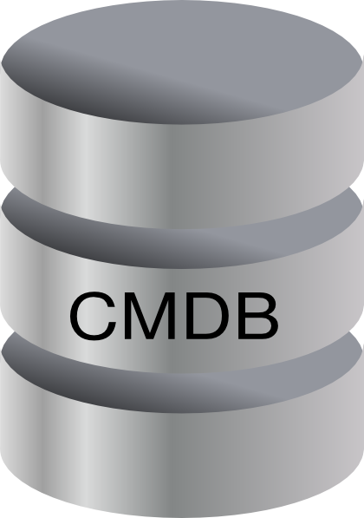
Server mapping => <Role>_<ReleaseState>
Salt-Master
Pillar Data
Server1 Pillar
cmdb:
name: Server1
ip: 1.1.1.1
salt_environment: nameserver_nrt
External Pillar Call
Server2 Pillar
cmdb:
name: Server2
ip: 2.2.2.2
salt_environment: nameserver_ga
Server | IP | Salt_environment
Server1 | 1.1.1.1
Server2 | 2.2.2.2
Server3 | 3.3.3.3
Server4 | 4.4.4.4
Server3 Pillar
nameserver_nrt
cmdb:
name: Server3
ip: 3.3.3.3
salt_environment: caching_ga
nameserver_ga
caching_ga
nameserver_ga
Notes:
Start time: 0:25
Length: 4
Transition:
At last – ready to build custom environments
Slide Goal: How our “environments” differ from typical use case.
Ignore Salt Environment definitions on this slide – Define on the previous slide.
Explain standard salt example environments.
Explain how ours differ
Role in a release state. (i.e. Nameserver in Trial, or Nameserver in GA)
have made the environments more flexible by building on the fly based on pillar information.
Comments.
Matt: Rework the slide to make less busy
Jason: Should we have to define environments or not?
Either use animations or break apart slides.

Slide 9
Building Custom Environments – create_envs
nameserver_ga
salt-master
Pillar: create_envs.sls
nameserver_ga
/srv/formulas/nameserver_ga/
metricbeat
users
app_nameserver
role_nameserver
Versioned Formulas /srv/versioned_formulas/
metricbeat_7.3/metricbeat
metricbeat_7.3/metricbeat.sls
metricbeat_7.4/metricbeat
metricbeat_7.4/metricbeat.sls
users_1.5/users
users_1.5/users.sls
app_nameserver_19.10/app_nameserver
app_nameserver_19.10/app_nameserver.sls
app_nameserver_19.11/app_nameserver
app_nameserver_19.11/app_nameserver.sls
role_nameserver_1.3/role_nameserver
role_nameserver_1.3/role_nameserver.sls
nameserver_ga:
formulas:
metricbeat:
version: 7.4
users:
version: 1.5
app_nameserver:
version: 19.10
role_nameserver:
version: 1.3
nameserver_nrt:
formulas:
metricbeat:
version: 0.1.1
users:
version: 0.1.1
additional_pillars:
- group.ops_users
app_nameserver:
version: 19.10
role_nameserver:
version: 0.1.3
caching_ga:
formulas:
metricbeat:
version: 0.1.1
users:
version: 0.1.1
…
Build Directory Structure
/srv/formulas/nameserver_ga
/srv/pillars/nameserver_ga
2) Add environment configs
/srv/pillars/nameserver_ga/
metricbeat.sls
users.sls
app_nameserver.sls
role_nameserver.sls
3) Assign Minion to the environment
4) Repeat for all environments
/etc/salt/master.d/env.conf
pillar_roots:
nameserver_ga:
- /srv/pillar/nameserver_ga
…
file_roots:
nameserver_ga:
- /srv/salt
- /srv/formulas/nameserver_ga
…
/etc/salt/minion.d/saltenv.conf
salt-minion
pillarenv: nameserver_ga
saltenv: nameserver_ga
Notes:
Start time: 0:29
Length: 5
Transition:
Have custom environments
How do we use them
Troy: Add notes for symlinks.

Slide 10
New Formula Version
Versioned Formulas /srv/versioned_formulas/
metricbeat_7.4/metricbeat
metricbeat_7.4/metricbeat.sls
users_1.5/users
users_1.5/users.sls
users_1/5/group/ops_users.sls
app_nameserver_19.10/app_nameserver
app_nameserver_19.10/app_nameserver.sls
app_nameserver_19.11/app_nameserver
app_nameserver_19.11/app_nameserver.sls
Update Formula
New Version
Failure
Automated Testing
Passed
Deploy To
Salt-Master
app_nameserver 19.11
New version now available
Update create_envs pillar
Update 19.10 -> 19.11
Pillar: create_envs.sls
nameserver_nrt:
formulas:
metricbeat:
version: 7.4
users:
version: 1.5
app_nameserver:
version: 19.10
version: 19.11
role_nameserver:
version: 0.1.3
…
Updated environments defined
Apply
create_envs
Environments setup
Apply role formula
Notes:
Start time: 0:34
Length: 4
Transition:
Now have new code
Environments all wrong
QA vs Prod
Update Formula
New Version
Could be configs or code
Automated Testing
Deploy to Salt Master
Nothing is using this version yet
Update create_envs pillar
References new version
Applies only to updated role and release state
Apply create_envs
Rebuild environment
Apply role formula to the server

Slide 11
Rebuilding Environment(s) – create_envs
Pillar: create_envs.sls
Rebuild all Environments
nameserver_nrt
Versioned Formulas /srv/versioned_formulas/
metricbeat_7.3/metricbeat
metricbeat_7.3/metricbeat.sls
metricbeat_7.4/metricbeat
metricbeat_7.4/metricbeat.sls
users_1.5/users
users_1.5/users.sls
app_nameserver_19.10/app_nameserver
app_nameserver_19.10/app_nameserver.sls
app_nameserver_19.11/app_nameserver
app_nameserver_19.11/app_nameserver.sls
role_nameserver_1.3/role_nameserver
role_nameserver_1.3/role_nameserver.sls
nameserver_nrt:
formulas:
metricbeat:
version: 7.4
users:
version: 1.5
additional_pillars:
- group.ops_users
app_nameserver:
version: 19.10
version: 19.11
role_nameserver:
version: 0.1.3
…
/srv/formulas/nameserver_nrt/
metricbeat
users
app_nameserver
role_nameserver
nameserver_nrt
/srv/pillars/nameserver_nrt/
metricbeat.sls
users.sls
app_nameserver.sls
role_nameserver.sls
Notes:
Start time: 0:34
Length: 4
Transition:
Solution shines during promotion process

Slide 12
Promoting a Release State
All versions already available
Pillar: create_envs.sls
Pillar: create_envs.sls
nameserver_nrt:
formulas:
metricbeat:
version: 7.4
users:
version: 1.5
additional_pillars:
- group.ops_users
app_nameserver:
version: 19.11
role_nameserver:
version: 0.1.3
nameserver_ga:
formulas:
metricbeat:
version: 7.3
users:
version: 1.5
additional_pillars:
- group.ops_users
app_nameserver:
version: 19.10
role_nameserver:
version: 0.1.3
…
nameserver_nrt:
formulas:
metricbeat:
version: 7.4
users:
version: 1.5
additional_pillars:
- group.ops_users
app_nameserver:
version: 19.11
role_nameserver:
version: 0.1.3
nameserver_ga:
formulas:
metricbeat:
version: 7.3
version: 7.4
users:
version: 1.5
additional_pillars:
- group.ops_users
app_nameserver:
version: 19.10
version: 19.11
role_nameserver:
version: 0.1.3
…
No deploy necessary
Update create_envs pillar
NRT -> GA
Updated environments defined
Apply
create_envs
Rebuild Environments
Apply role formula
Notes:
Start time: 0:38
Length: 2
Transition:
And finally – apply a role state to a server
QA vs Prod
How does formula pass through all 5 environments
From NRT -> GA
All Formula Versionameserver Available
Have already been validated
Update create_envs pillar
Match ga environment config to nrt environment
Apply create_envs
Rebuild environment(s)
Apply role formula to the server(s)
NOTES:
* REWORK to 2 different pictures. (One using the create_envs pillar picture from 2 slides ago.)

Slide 13

Applying role formulas
t⁰
t¹
t²
Apply Role Formulas
Apply Environment Changes
create_envs
Apply Role Formulas
Requirements
NRT
Must support simple promotion from one release state to the next
Server roles must share Salt States and Formulas
Repair Automation must bring any server back up to its prior state
Must support server moves between both release states and roles
Deployments must only affect a single release state and role
nameserver_nrt
Formula | Version
metricbeat | 7.4
users | 1.5
app_nameserver | 19.11
role_nameserver | 1.3
nameserver_nrt
Formula | Version
metricbeat | 7.4
users | 1.5
app_nameserver | 19.11
role_nameserver | 1.3
nameserver_nrt
Formula | Version
metricbeat | 7.4
users | 1.5
app_nameserver | 19.11
role_nameserver | 1.3
GA
nameserver_ga
Formula | Version
metricbeat | 7.3
users | 1.5
app_nameserver | 19.10
role_nameserver | 1.3
nameserver_ga
Formula | Version
metricbeat | 7.3 7.4
users | 1.5
app_nameserver | 19.10 19.11
role_nameserver | 1.3
nameserver_ga
Formula | Version
metricbeat | 7.4
users | 1.5
app_nameserver | 19.11
role_nameserver | 1.3
Notes:
Start time: 0:40
Length: 4-5
Transition:
So what questions are there
QA vs Prod
How does formula pass through all 5 environments
From NRT -> GA
All Formula Versionameserver Available
Have already been validated
Update create_envs pillar
Match ga environment config to nrt environment
Apply create_envs
Rebuild environment(s)
Apply role formula to the server(s)
NOTES:
* REWORK to 2 different pictures. (One using the create_envs pillar picture from 2 slides ago.)

Slide 14

Q & A
Notes:
Possibly dump this slide.
Matt – add implementation details about config_items. – External_Pillar

Slide 15

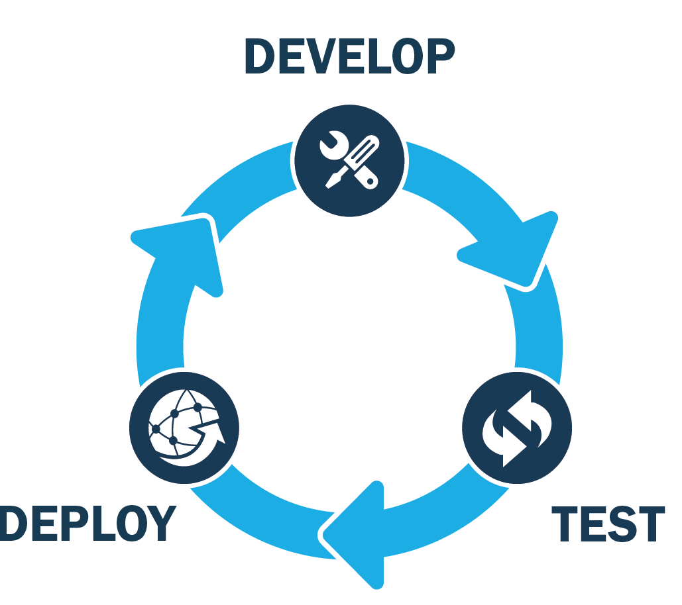




Additional Considerations
Community Formulas
External Pillar
Kitchen-Salt
Jenkins
Deploy Tools
CI/CD
Salt Hierarchy
Notes:
Deployment
Tool to identify which formulas must be deployed to which master
CMDB
Use CMDB as an external pillar
Master Syndic relationship
We deploy all versions of all formulas to Master of Masters
Syndics pull down all necessary formulas during create_envs process
Version Control
Tagging every release – we use git hooks to ensure consistent tagging
We chose not to use gitfs due to firewall restrictions
Automated Testing
Suggest using Kitchen-Salt
Can plug into any CI/CD pipelines (we use gitlab)
Saltstack formulas
Use many community formulas, requires a bit of tweaking to fit in this model.

